Slide 1
Hepmil Interview Assignment
Creating an r/memes web crawler

Slide 2
01
Live Demo

Slide 3
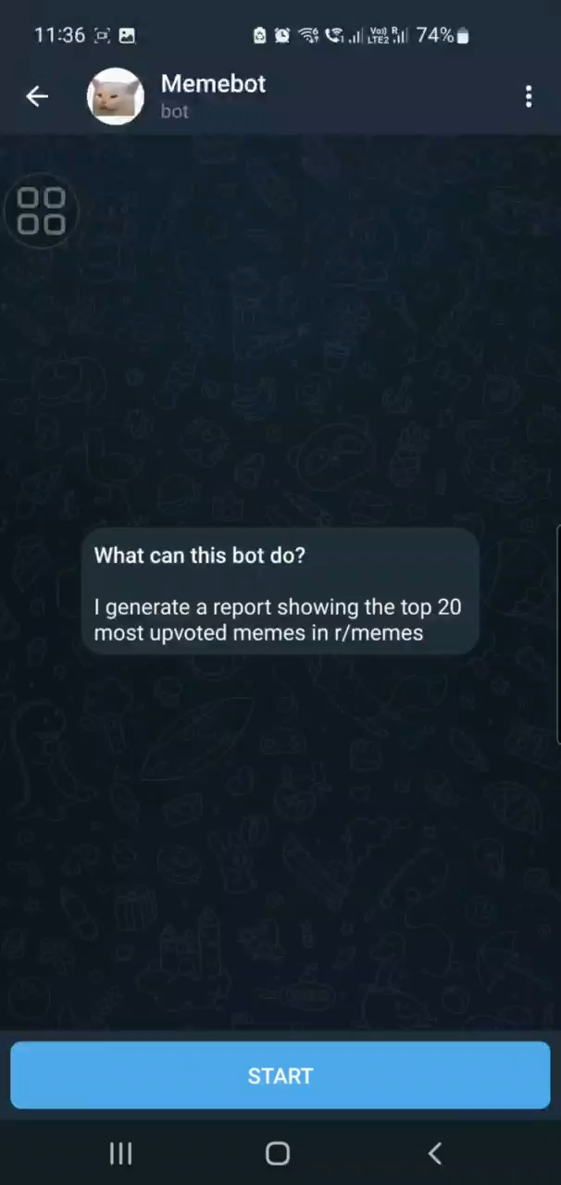
It’s live!
The bot is currently up and running ☺
Try the bot yourself in Telegram!
Tele handle: @Fuyen_bot
PS: The report generation may take some time, need advice on how to speed things up

Slide 4
02
Implementation Details

Slide 5


How it works
Hosted on
generates
pulls from
calls
calls
PDF
Report
Generator
PostgreSQL
retrieved and sent by
stores to
interacts with
Telegram
Bot
Crawler
scheduled calls
User
Cron
Language: Python

Slide 6
Database (PostgreSQL)
Memes Table
Votes table
Unique records of name, title, author, url and thumbnail url of posts that have appeared in daily top 20s
New entry only when new post enters top 20
Records the upvote and downvote counts of the top 20 posts regularly
Votes data are crawled every 10 minutes
Votes data that are more than 24hrs ago are deleted

Slide 7
Python Components
Crawler
Telegram Bot
Generator
Crawls top posts from r/meme using asyncpraw (reddit API wrapper)
Connects to database
Creates tables in the database (if not exist)
Inserts and deletes data from the tables
Scheduled run by cron, every 10 minutes
Implemented using python-telegram-bot library
Handles /start, /generate and /help commands from user. Calls generator on /generate command.
Simple polling, not using webhook / API frameworks
Calls crawler to fetch latest data
Queries database for current top 20 memes, and their vote histories
Plots vote history graph
Generates report first in HTML format, then converted to PDF

Slide 8
Source Code
The repo is available on my GitHub
https://github.com/Fuyen999/Hepmil_Assignment

Slide 9
03
Actionable Insights

Slide 10
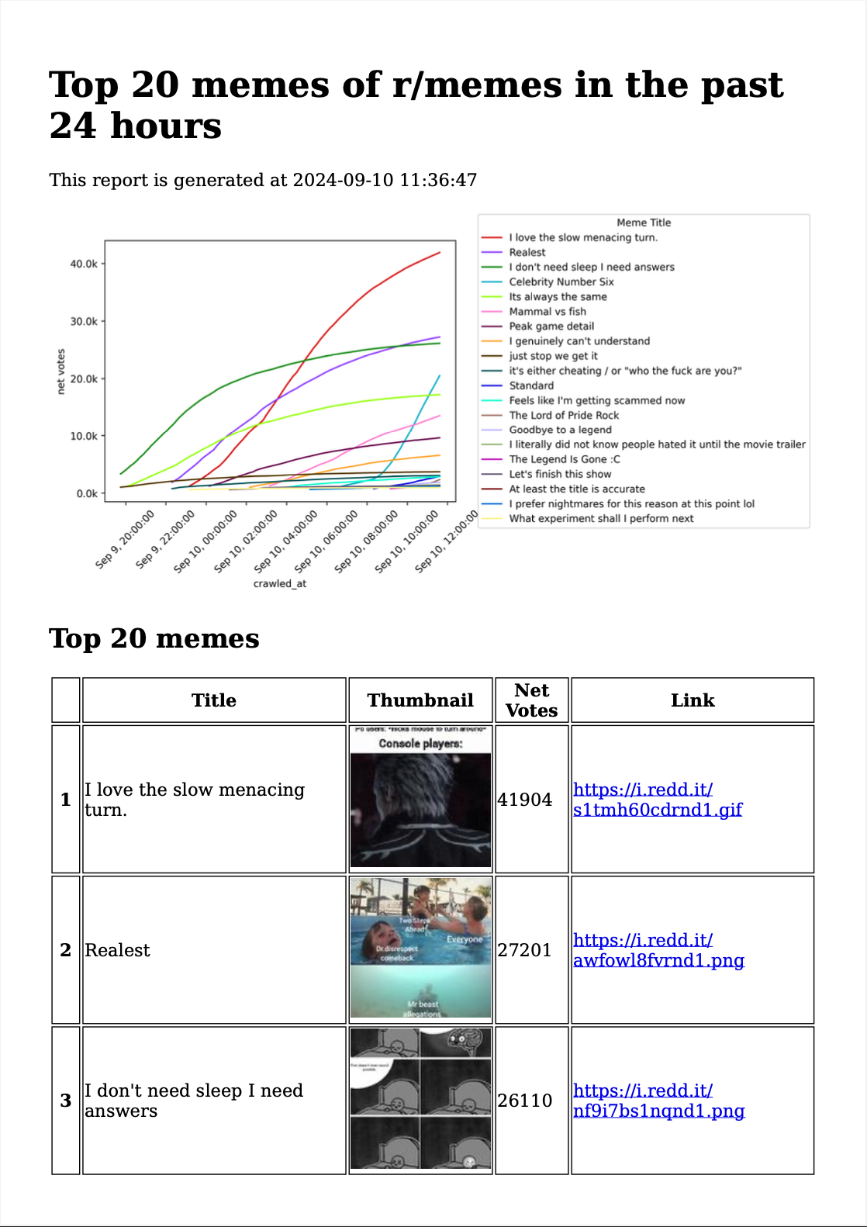
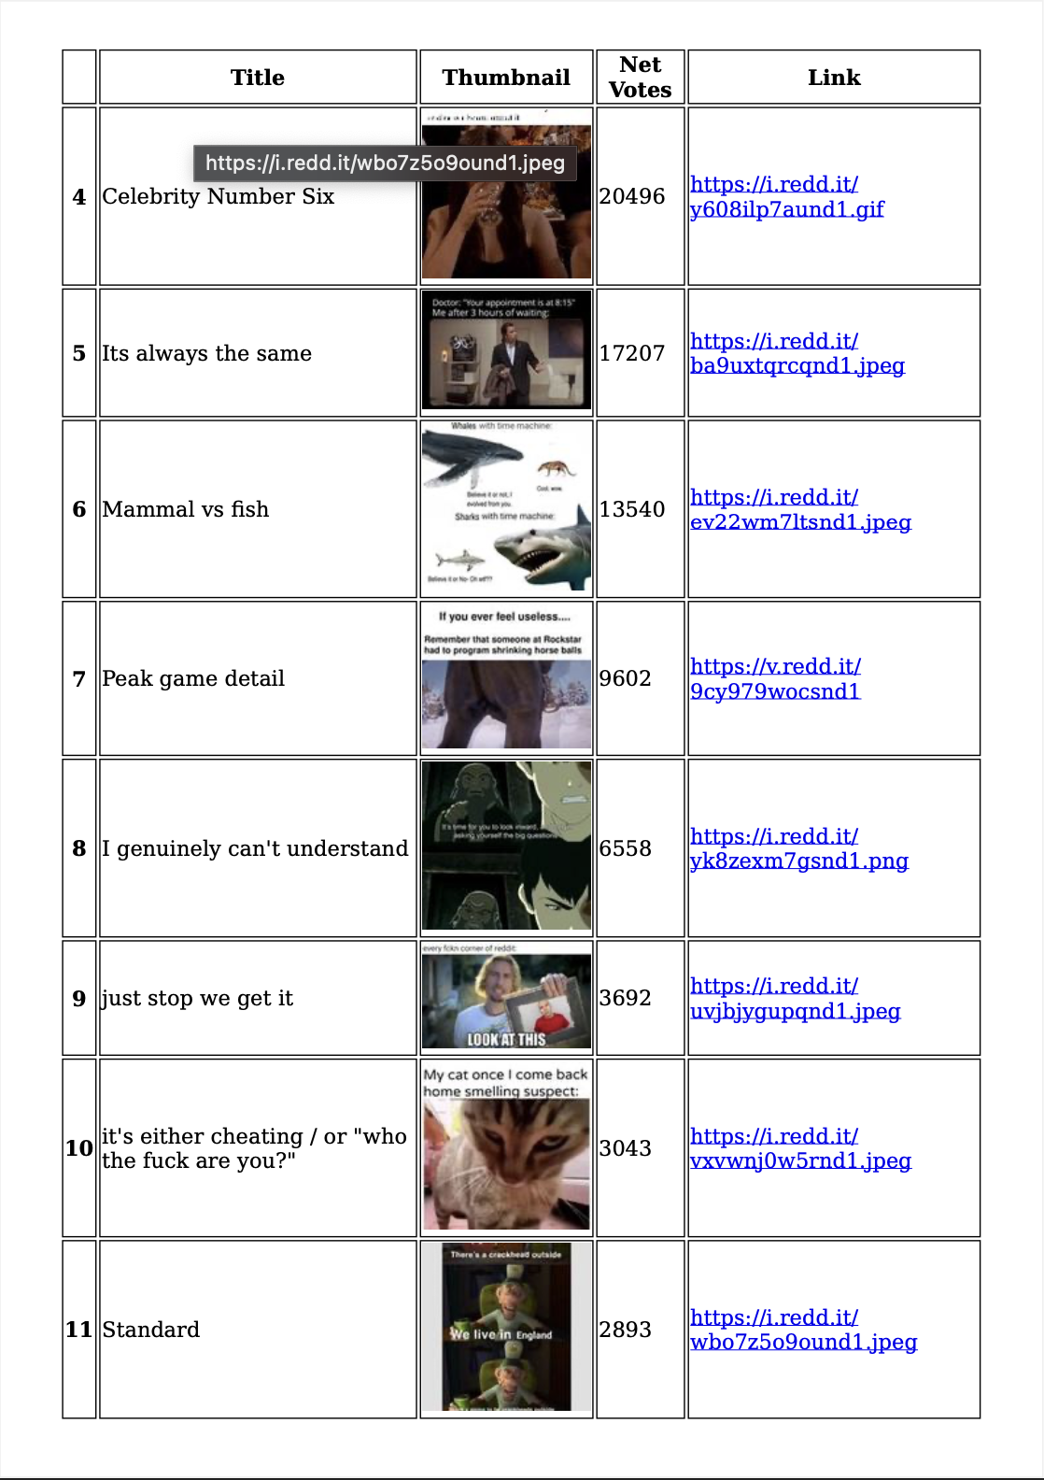
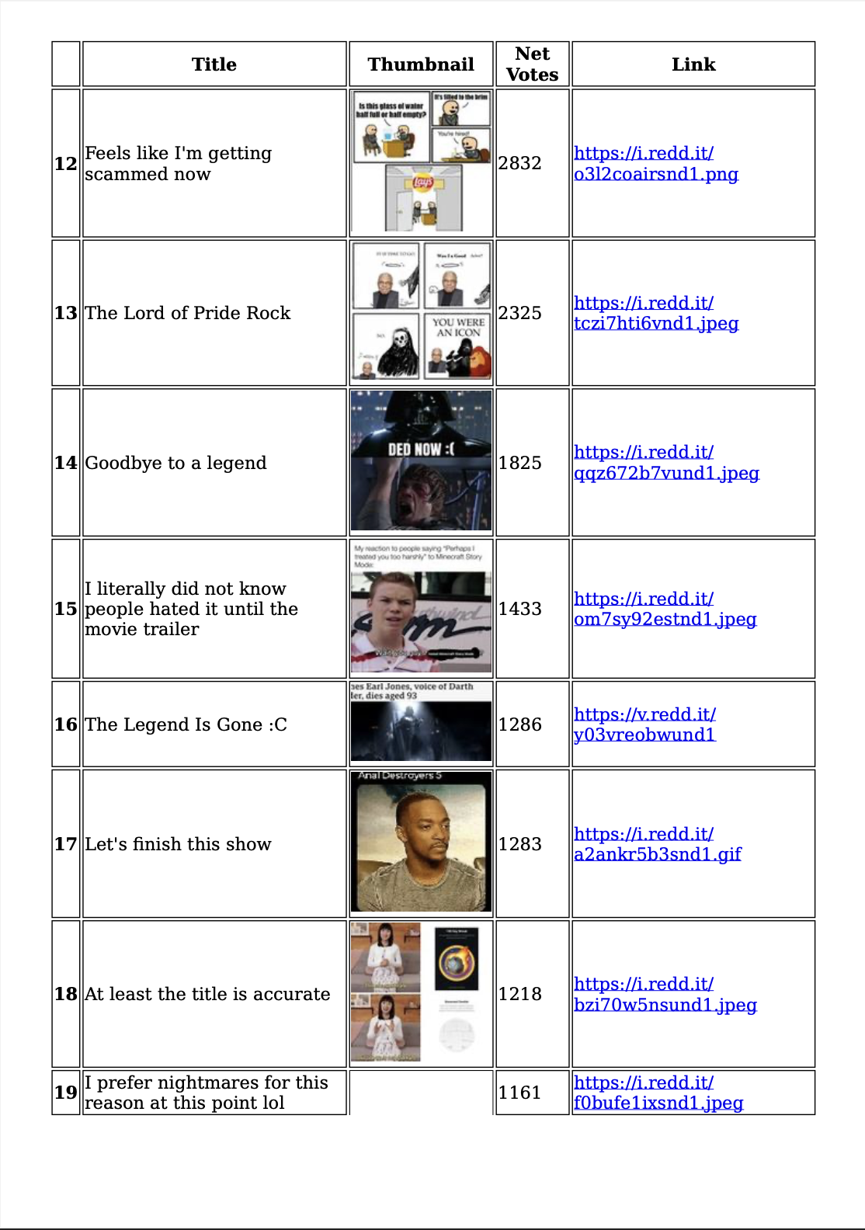
Generated Report

Slide 11
Insights
01 Sigmoid Curve
02 Popular memes
Top meme posts vote patterns generally follow a sigmoid curve (getting votes slower at the start, increase rapidly in the middle, then plateaus)
So leave your post up even if it does not gain too much votes at the start
6 of the top 10 memes are related to gaming / online culture
The 13th, 14th and 16th top memes are about the recent death of Darth Vader voice actor James Earl Jones. The 15th top meme is also related to movie culture (Minecraft story movie trailer)
The titles of the top posts are short
can’t think of any other insights liao

Slide 12
Thanks!
Do you have any questions?
yewfy99@gmail.com
+65 8904 5140
https://www.linkedin.com/in/fuyen99/
Please keep this slide for attribution

